Slide 1

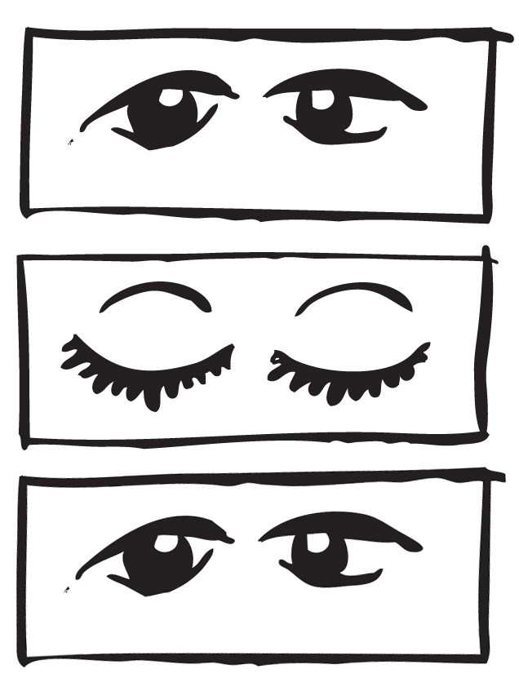







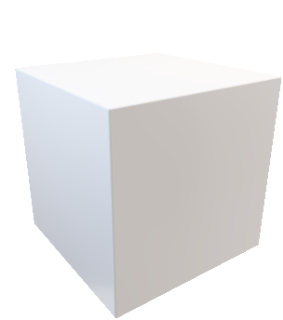
凝视射线

Slide 2
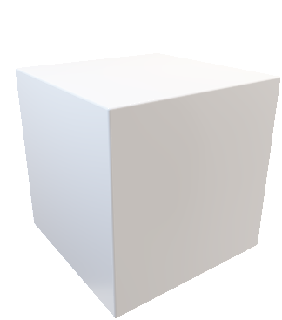


y
y
y
x
x
x
head forward
gaze forward
gaze forward
1
2
3
4
···
double blinking to confirm and select the target object
progress bar getting full to enter a certain manipulation mode (e.g., rescaling)
double blinking to confirm the manipulation and return to “Clover”
Return to browsing or continue manipulating the current object

